Slide 1
LECTURE 14
MECHANICS OF DEFORMABLE BODIES
LECTURE 15
LECTURE 16
LECTURE 17
LECTURE 18
LECTURE 19
LECTURE 20
TUTORIAL 8
TUTORIAL 9
TUTORIAL 10

Slide 2
LECTURE 14
Contents:
Introduction
Mechanical properties of materials
Normal stress and strain
Hooke’s law
Modulus of elasticity
HOME

Slide 3
Introduction
Strength of materials or mechanics of materials involves analytical methods for determining the strength, stiffness (deformation characteristics), and stability of various load carrying members.
Strength is the ability of the structure to resist the influence of the external forces acting upon it.
Stiffness is the ability of the structure to resist the strains caused by the external forces acting upon it.
Stability is the property of the structure to keep its initial position of equilibrium.
Notes:
Introduction:
There are different types of structures built by man-buildings, bridges, water tanks, roads, transmission towers, machines etc. Such structures are built up of a number of structural elements joined together suitably. In the case of any structure, two types of designs are involved-functional or architectural and structural. Functional or architectural design deals with aspects other than strengths of the structure, like aesthetics, utility, orientation, general layout etc. Once this important aspect of design is taken care of, structural designers take over. Their work involves analysis of the structure and its elements to find the forces and moments that they have to withstand and then design the dimensions of the elements and their interconnections. Structures are designed to withstand loads, that is, forces and moments due to different causes. The subject strength of materials deals with the relations between externally applied loads and their internal effects on bodies. The bodies are no longer assumed to be rigid and the deformations, however small, are of major interest.
Strength of materials is an inter-disciplinary subject. Mechanical and chemical engineers need this subject to know the strength of various materials for the design of machineries and pressure vessels. Civil engineers need this subject for the design of trusses, slabs, beams, columns etc., of buildings and bridges. Aeronautical engineers need this subject for the design of aircraft. Similarly mining, electrical, electronics and computer engineers should also know this subject for one or the other reason.
An important aspect of the analysis and design of structures relates to the deformations caused by the loads applied to a structure. Clearly, it is important to avoid deformations so large that they may prevent the structure from fulfilling the purpose for which it was intended. By considering engineering structures as deformable and analyzing the deformations in their various members, it will be possible for us to compute forces that are statically indeterminate i.e. indeterminate within the framework of statics. To determine actual distribution of stresses within a member, it is necessary to analyze the deformations that take place in that member.
Strength of materials or mechanics of materials involves analytical methods for determining the strength, stiffness (deformation characteristics), and stability of various load carrying members.

Slide 4
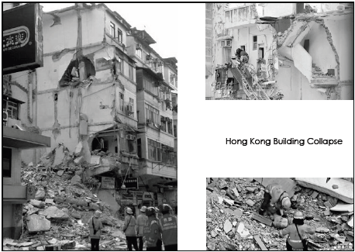
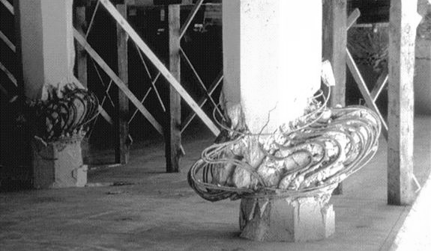

Insufficient compressive strength of column
Inadequate strength of load bearing structure
The strength of a material is its ability to withstand an applied stress without failure.
The applied stress may be tensile, compressive, or shear.
Insufficient strength of beam

Slide 5
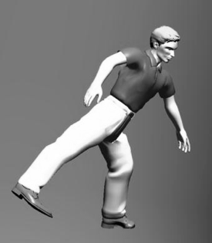

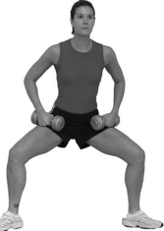

Falling body
Squatting body
CCTV Tower, Beijing
Realia Torre, Madrid
The state or quality of being stable, especially the resistance to change, deterioration, or displacement.

Slide 6
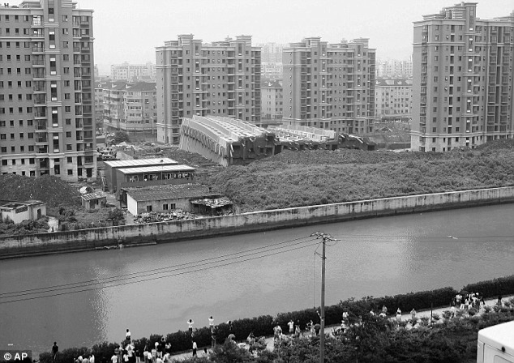
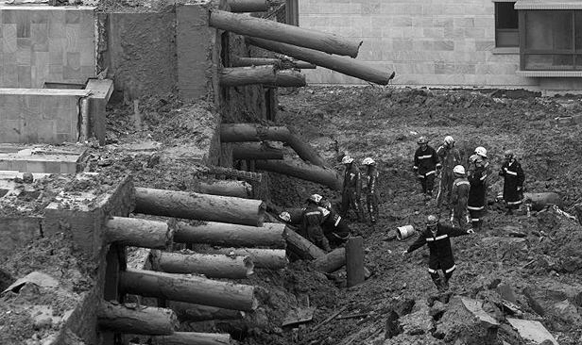
Shanghai Building Collapse, 2009

Slide 7
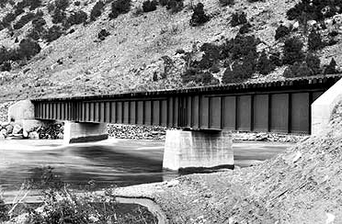

Different Stiffness
Suspension bridge for foot path
Rigid Beam bridge for train
Stiffness is the resistance of an elastic body to deformation by an applied force along a given degree of freedom.

Slide 8

Elasticity
Plasticity
Ductility
Brittleness
Malleability
Notes:
Mechanical properties of materials:
The following are the most important mechanical properties of engineering materials.
Elasticity:
Elasticity is the property by virtue of which a material deformed under the load is enabled to return to its original dimension when the load is removed. If a body regains completely its original shape, it is said to be perfectly elastic.
Plasticity:
Plasticity is the property by virtue of which a material is permanently deformed by the application of load and it has no tendency to recover. Every elastic material possesses the property of plasticity. Under the action of large forces, most engineering materials become plastic and behave in a manner similar to a viscous liquid.
Ductility:
Ductility is the property of a material which permits it to be drawn out in to slender rod or wire. Wrought metals such as steel, wrought iron, alloys of aluminium and alloys of copper are ductile. Ductile metals have high degree of plasticity beyond the elastic limit. Ductility is measured by the percentage of elongation occurring in a given distance between two points marked on the specimen along its length.
Brittleness:
Brittleness in a material is indicated by its ability to undergo only slight deformation before rupturing. Brittle materials are much stronger in compression than in tension. Most cast metals are brittle immediately after casting.
Malleability:
If the shape of a metal body can be altered by hammering or rolling the body without cracking or breaking the metal, the metal is said to be Malleable.
Toughness:
The toughness of materials is its ability to withstand, without fracture, large stresses accompanied by large deformations. The measure of toughness is the amount of work absorbed per unit volume, by the material before it fails.
Hardness:
The hardness of a material is determined by its ability to resist abrasions and indentations. Hardness is a relative quantity.
In a crank shaft bearing in an internal combustion engine it is desirable to have the bearing metal softer than the metal of the crank shaft to eliminate the possibility of running the crankshaft itself in case of insufficient lubrication.
Strength:
The strength of a material enables it to resist fracture under load. The load required to cause fracture divided by the area of the test specimen, is termed as the ultimate strength of the materials and is expressed in the unit of stress.
Homogeneity and Isotropy:
A material is homogeneous if it has same composition throughout the body. For such a material, the elastic properties are same at each and every point in the body. If a material is equally elastic in all directions it is said to be isotropic.
Creep:
A slow but progressive deformation in engineering materials is referred to as creep. Where metals are used in regions of high temperatures, such as in furnaces and in jet engines, considerations of creep is essential in design.
The maximum stress to which a material can be continuously subjected at a specified elevated temperature without causing more than a specified amount of inelastic deformation in a specified time is called creep strength, metal with a low melting temperatures, such as lead, zinc and tin may exhibit creep at room temperature.

Slide 9
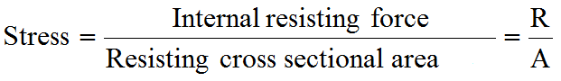
Normal stress
P
P
R
A
B
The body resists the deformation by developing stresses.
R
P
P
Notes:
Normal stress and strain:
Whenever a body is subjected to forces, the body deforms. The bodies in practice are not rigid. The body resists the deformation by developing stresses. The body reaches an equilibrium position when the internal stress resultant equals the external force. The deformation of the body and the stress can be related for any body depending upon its material property.
No engineering material is perfectly rigid and hence, when a material is subjected to external load, it undergoes deformation. While undergoing deformation, the particles of the material offer a resisting force (internal force). When this resisting force equals applied load the equilibrium condition exists and hence the deformation stops. These internal forces maintain the externally applied forces in equilibrium.
The internal force resisting the deformation per unit area is called as stress or intensity of stress.
Consider a uniform bar of cross sectional area A, subjected to a tensile force P. Consider a section AB normal to the direction of force P. Let R is the total resisting force acting on the cross section AB.
Then for equilibrium condition, R = P
Then from the definition of stress, normal stress =
Symbol: σ = Normal Stress
Intensity of resisting force perpendicular or normal to the section is called the normal stress.

Slide 10

Normal Stress
Tensile Stress
Compressive Stress
P
P
P
P
Notes:
Normal stress may be tensile or compressive.
Tensile stress: Stresses that cause pulling on the surface of the section, (particles of the materials tend to pull apart causing extension in the direction of force).
Compressive stress: Stresses that cause pushing on the surface of the section, (particles of the materials tend to push together causing shortening in the direction of force).

Slide 11
Units:
SI unit for stress is Pascal (Pa)
Pa= N/m²
 | N/m² | N/mm²
1kPa | 10³ | 10⁻³
1MPa | 10⁶ | 1
1GPa | 10⁹ | 10³
Kilopascal, 1kPa= 1000 N/m²
Megapascal , 1MPa = 1x 10⁶ N/m²
⁼ 1x 10⁶ N/(10⁶ mm² )=1N/mm²
1MPa = 1 N/mm²
Gigapascal, 1GPa = 1x 10⁹ N/m²
⁼ 1x 10³ MPa
=1x 10³ N/mm²

Slide 12
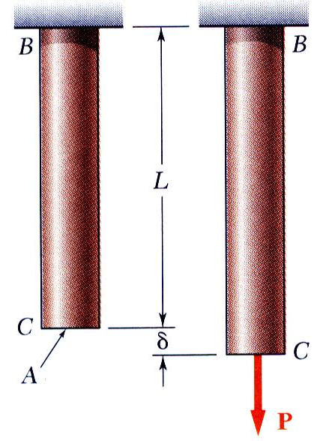
STRAIN
Notes:
Strain:
When a load acts on the material it will undergo deformation. is a measure of deformation produced by the application of external forces.
If a bar is subjected to a direct load, and hence a stress, the bar will changes in length. If the bar has an original length L and change in length by an amount δL, the linear strain produced is defined as,
Linear strain,
Strain is a dimensionless quantity

Slide 13
E=
Hooks law and Modulus of elasticity
Hooks law:
Modulus of elasticity:
Notes:
Hooke’s Law:
For all practical purposes, up to certain limit the relationship between normal stress and linear strain may be said to be linear for all materials
stress (σ) α strain (ε)
Thomas Young introduced a constant of proportionality that came to be known as Young’s modulus.
Young’s Modulus is defined as the ratio of normal stress to linear strain within the proportionality limit.
The value of the Young’s modulus is a definite property of a material. From the experiments, it is known that strain is always a very small quantity, hence E must be large.

Slide 14
The following table shows modulus of elasticity
of important materials:
Material | Modulus of elasticity
Steel | 210 GPa
Aluminium | 73Gpa
Brass | 96 – 110 GPa
Cast Iron | 83 – 170 GPa
Concrete | 17 – 31 GPa
Rubber | 0.0007 – 0.004 GPa
Tungsten | 340 – 380 GPa

Slide 15
Tension test on ductile and brittle material Factor of safety Allowable stress
HOME

Slide 16
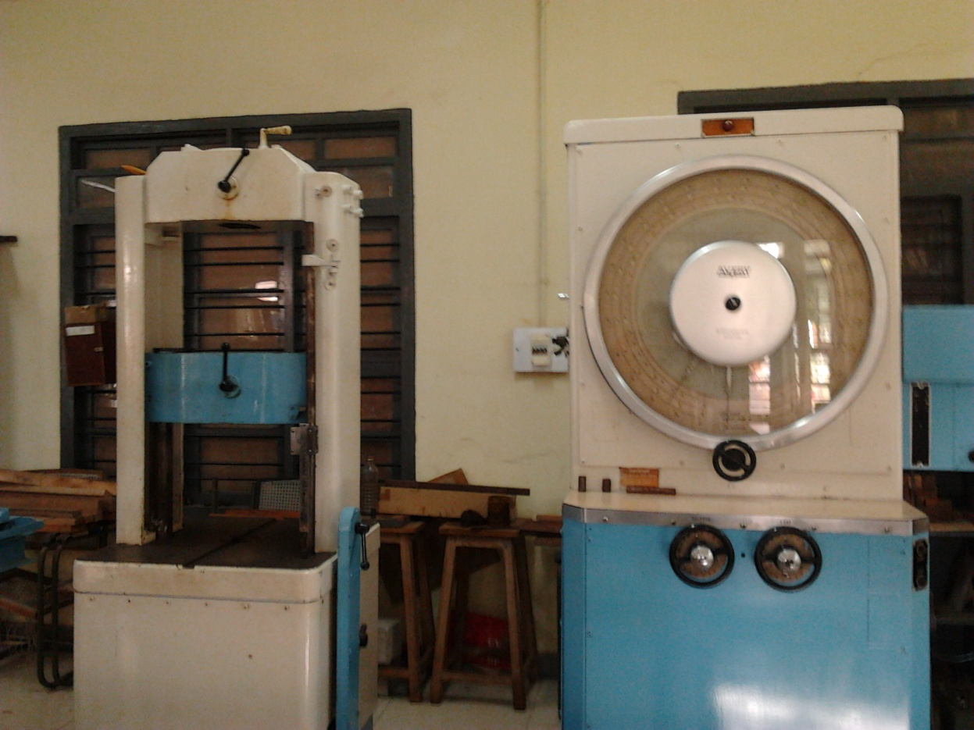
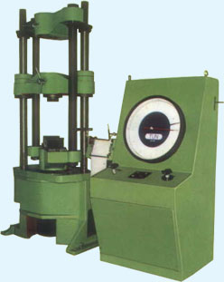
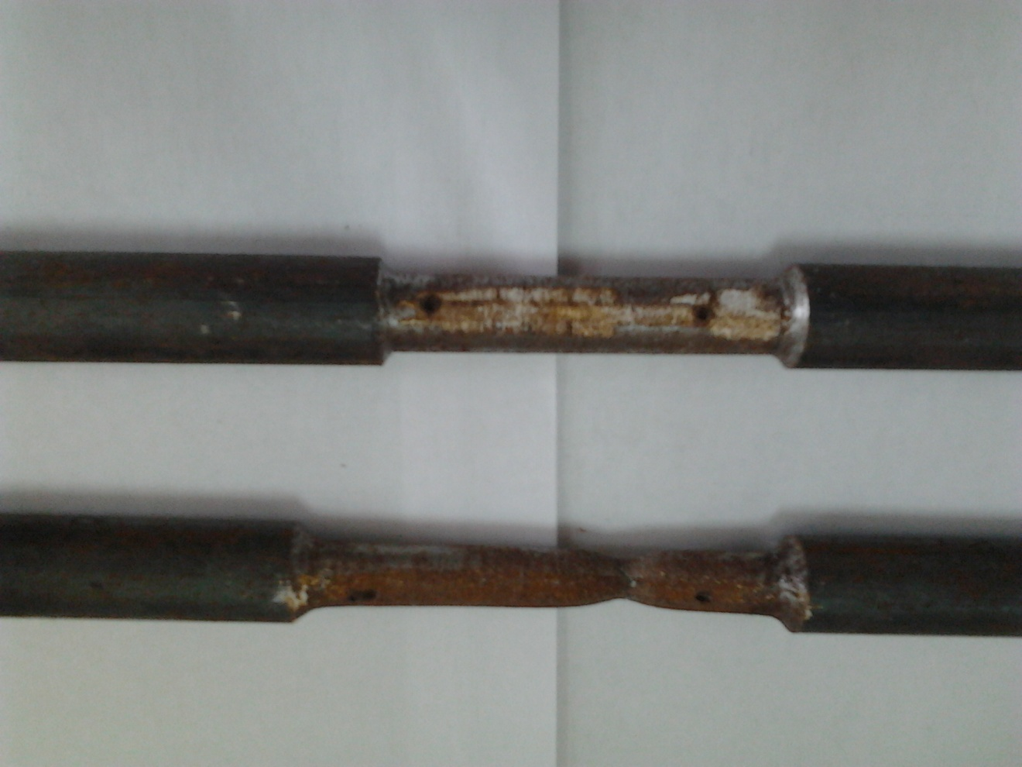
Tension test on ductile and brittle material
Notes:
In order to compare the strength of various materials it is necessary to carry out some standard form of test to establish their relative properties.
One such test is the standard tensile test in which a circular bar of uniform cross section is subjected to a gradually increasing tensile load until failure occurs.
Measurement of change in length over a selected gauge length of the bar are recorded throughout the loading operation by means of extensometers.
The stress and strain relation of any material is obtained by conducting tension test in the laboratories on standard specimen, different materials behave differently and their behaviour in tension and in compression differ slightly.
If a piece of ductile material is subjected to a gradually increasing pull in a tensile testing machine, it is found that the resultant strain is directly proportional to the corresponding stress upto a certain limit only and beyond that the relation is not linear. In investigating mechanical properties of materials beyond this limit, the relationship between the strain and the corresponding stress is usually represented graphically by a tensile test diagram.

Slide 17
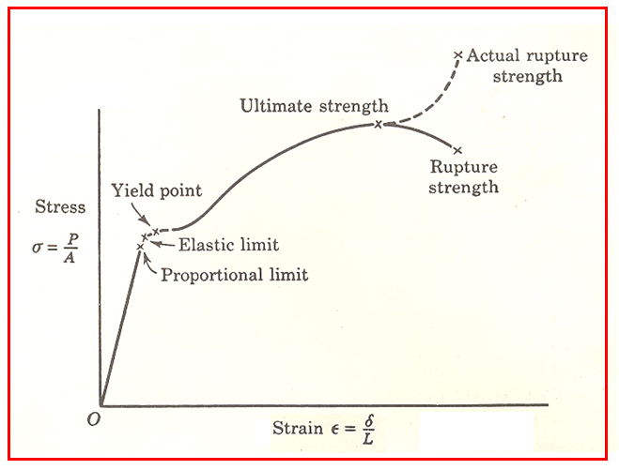
STRESS-STRAIN DIAGRAM
Typical tensile test curve for mild steel
Notes:
A graph of stress verses strain is drawn as shown in figure.
In order to compare the strength of various materials it is necessary to carry out some standard form of test to establish their relative properties.
One such test is the standard tensile test in which a circular bar of uniform cross section is subjected to a gradually increasing tensile load until failure occurs.
Measurement of change in length over a selected gauge length of the bar are recorded throughout the loading operation by means of extensometers.
The stress and strain relation of any material is obtained by conducting tension test in the laboratories on standard specimen, different materials behave differently and their behaviour in tension and in compression differ slightly.
If a piece of ductile material is subjected to a gradually increasing pull in a tensile testing machine, it is found that the resultant strain is directly proportional to the corresponding stress upto a certain limit only and beyond that the relation is not linear. In investigating mechanical properties of materials beyond this limit, the relationship between the strain and the corresponding stress is usually represented graphically by a tensile test diagram.

Slide 18
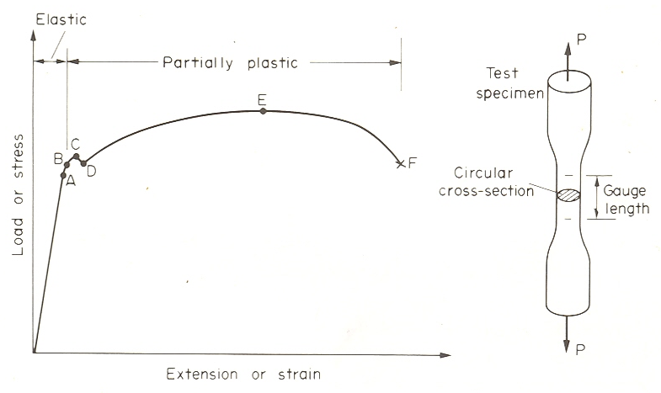
STRESS-STRAIN DIAGRAM
Typical tensile test curve for mild steel showing upper yield point and lower yield point and also the elastic range and plastic range

Slide 19
Limit of Proportionality:
Elastic limit:
Yield point:
Ultimate strength:
Rupture strength
(Nominal Breaking stress):
True breaking stress:
Notes:
Limit of Proportionality :
From the origin O to a point A is called proportionality limit the stress strain diagram is a straight line. That is stress is proportional to strain. Hence proportional limit is the maximum stress up to which the stress – strain relationship is a straight line and material behaves elastically.
From this we deduce the well known relation, first postulated by Robert Hooke, that stress is proportional to strain.
Beyond this point, the stress is no longer proportional to strain
σ = load at proportionality limit/Original Cross sectional Area
Elastic limit:
It is the stress beyond which the material will not return to its original shape when unloaded but will retain a permanent deformation called permanent set. For most practical purposes it can often be assumed that points corresponding proportional limit and elastic limit coincide.
Beyond the elastic limit, plastic deformation occurs and strains are not totally recoverable. There will be thus some permanent deformation when load is removed.
σ_{E} = load at elastic limit/Original Cross sectional Area
Yield point:
It is the point at which there is an appreciable elongation or yielding of the material without any corresponding increase of load.
σ_{y} = load at yield point /Original Cross sectional Area
Ultimate strength:
It is the stress corresponding to maximum load recorded during the test. It is stress corresponding to maximum ordinate in the stress-strain graph.
σ_{u} = Maximum load taken by the material /Original Cross sectional Area
Rupture strength (Nominal Breaking stress):
It is the stress at failure.
For most ductile material including structural steel breaking stress is somewhat lower than ultimate strength because the rupture strength is computed by dividing the rupture load (Breaking load) by the original cross sectional area.
σ_{B} = load at breaking (failure)/Original Cross sectional Area
σ_{t} = load at breaking (failure)/Actual Cross sectional Area
After yield point the graph becomes much more shallow and covers a much greater portion of the strain axis than the elastic range.

Slide 20
Gauge length
Increase in gauge length

Slide 21
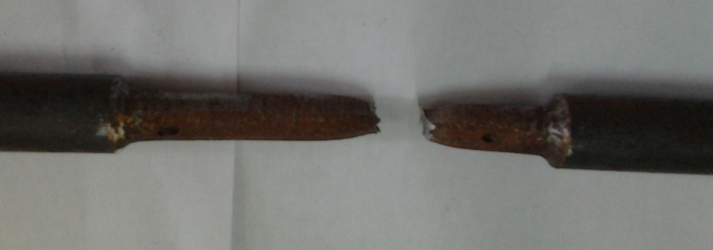
Ductile Materials
Percentage elongation
Measures of ductility
Percentage reduction in area
Cup and cone fracture for a Ductile Material ►
Example: Low carbon steel, mild steel, gold, silver, aluminum
Notes:
A measure of ductility is obtained by measurements of the percentage elongation or percentage reduction in area

Slide 22
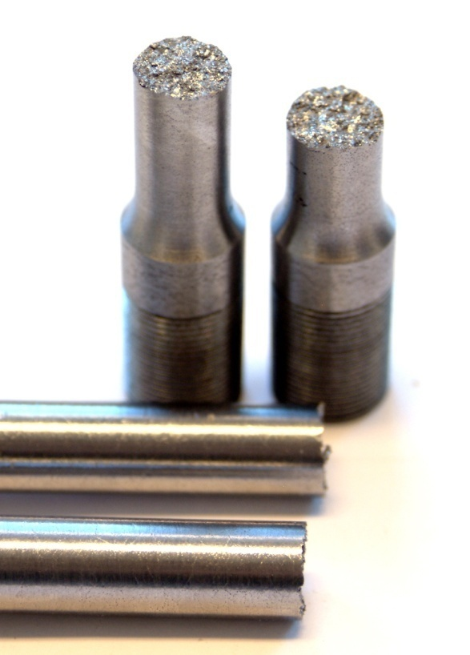
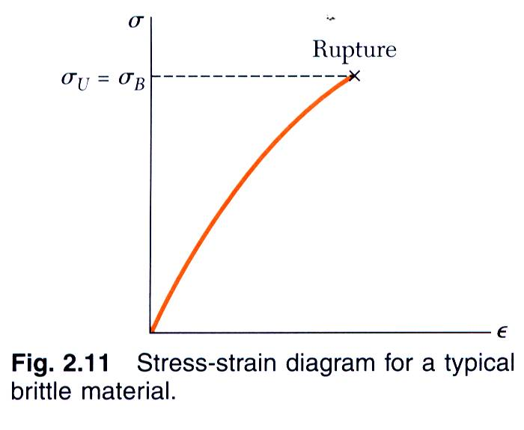
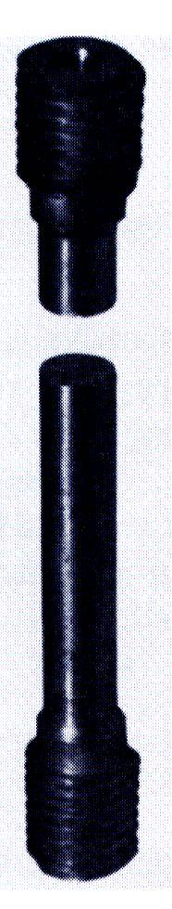
Stress-strain Diagram
Brittle Materials :
Stress-strain diagram for a typical brittle material
Notes:
A brittle material is one which exhibits relatively small extensions before fracture so that plastic region of the tensile test graph is much reduced.
Example: steel with higher carbon content, cast iron, concrete, brick

Slide 23
Working stress & Factor of safety
Ductile Material:
Working stress = Yield Stress / Factor of Safety
Brittle Material:
Working stress = Ultimate Stress / Factor of Safety
Factor of Safety = Maximum stress / Allowable working stress
Notes:
Working stress: It is obvious that one cannot take risk of loading a member to its ultimate strength, in practice. The maximum stress to which the material of a member is subjected to in practice is called working stress.
This value should be well within the elastic limit in elastic design method.
Working stress = Ultimate stress/ factor of safety for brittle material
Working stress = yield stress / factor of safety, for ductile material.
Factor of safety: Because of uncertainty of loading conditions, design procedure, production methods, etc., designers generally introduce a factor of safety into their design,
Factor of safety = Maximum stress / Allowable working stress
Failure implies that a component or a structure does not perform the function for which it was designed.
A machine component may interfere with other moving parts because of excessive deformation; a chair may feel rickety because of poor joint design; a gasket seal leaks because of insufficient deformation of the gasket at some points; lock washers may not deform enough to provide the spring force needed to keep bolted joints from becoming loose; a building undergoing excessive deformation may become aesthetically displeasing. These are examples of failure caused by too little or too much deformation.
The stiffness of a structural element depends on the modulus of elasticity of the material as well as on the geometric properties of the member, such as cross-sectional area, area moments of inertia, polar moments of inertia, and the length of the components.
Prevention of a component fracture is an obvious design objective based on strength. At other times, the design objective may be to avoid making a component too strong. The adhesive bond between the lid and a sauce bottle must break so that the bottle may be opened by hand; shear pins must break before critical components get damaged; the steering column of automobile must collapse rather than impale the passenger in a crash. Ultimate normal stress is used for assessing failure due to breaking or rupture particularly for brittle materials.
For structural steel and other similar ductile materials having definite yield stress, working stress is based on yield strength.
For brittle materials where there is no definite yield point, working stress is based on ultimate strength of the material.
While selecting the factor of safety and hence the working stress for a particular material, the following points are taken into consideration.
Nature of loading
Whether it is dead load or live load
Whether the load is applied gradually or suddenly
Whether the load is constant in type or alternating
Whether the load is for short duration or for long
Nature of the material
Whether the material is homogeneous and isotropic
Whether there are likely to be any weakness (such as internal flaws etc. )
Environmental factors
Effects of salt water and humidity
Effects of corrosion
Effects of wear
Previous histories- possible results of any failure
Workmanship- the possibility of errors occurring in manufacturing or fabrication

Slide 24
Numerical problems
LECTURE 16
Contents:
HOME

Slide 25
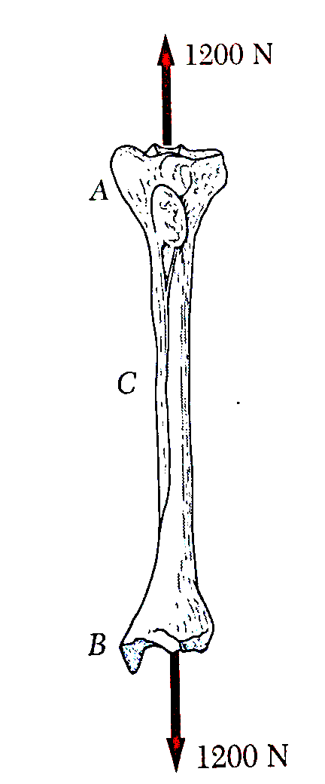
N1. A strain gauge located at C on the surface of bone AB indicates that the average normal stress in the bone is 3.80 MPa when the bone is subjected to two 1200 N forces as shown. Assuming the cross section of the bone at C to be annular and Knowing that its outer diameter is 25mm, determine the inner diameter of the bones cross section at C.

Slide 26
N2 A composite bar consists of an aluminum section rigidly fastened between a bronze section and a steel section as shown in figure. Axial loads are applied at the positions indicated. Determine the stress in each section. Also determine the change in each section and the change in total length.
Aluminum
A= 180 mm²
Steel
A= 160 mm²
Bronze
A= 120 mm²
4kN
13kN
2kN
7kN
300mm
400mm
500mm

Slide 27
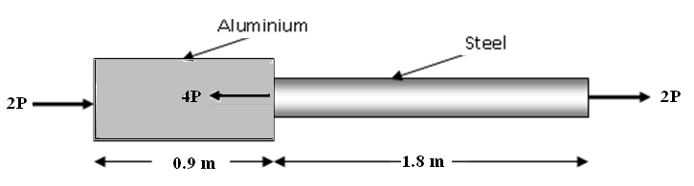
N3. An aluminum rod is fastened to a steel rod as shown. Axial loads are applied at the positions shown. The area of cross section of aluminum and steel rods are 400 mm² and 200mm² respectively. Find maximum value of P that will satisfy the following conditions.
σ_{s} ≤ 140 MPa
σ_{a} ≤ 80 MPa
Total elongation ≤ 0.5 mm,
Take E_{a} = 70 GPa and E_{s} = 210 GPa

Slide 28
N4. A member ABCD is subjected to point loads P1, P2,P3 and P4 as shown in figure below.
Calculate the force P3 necessary for equilibrium if P1 = 120 kN, P2 = 220 kN and P4 = 160 kN.
Determine the net change in the length of the member. Take E = 200 GN/m².
Given: area and length of AB: 1600 mm², 0.75 m ;
area and length of BC: 625 mm², 1.0 m;
area and length of CD: 900mm², 1.2 m.
A
B
C
D
P1
P2
P3
P4

Slide 29
LECTURE 17
Contents:
Expression for deformation of a tapered bar
Expression for deformation of a tapered flat
Application problems
HOME

Slide 30
N5. Find the modulus of elasticity of the material of a tapering bar from the following data: The bar has 20 mm diameter at one end, 40 mm diameter at the other, length 1.0 m and axial load of 10 kN. The elongation observed was 0.1 mm.
N6. A tapered bar of rectangular cross section is 20 mm wide at one end and 40 mm wide at the other, 8 mm thick and 800 mm long. The elongation of 0.08 mm was observed under load P. find the load P, if the modulus of elasticity of the material of the bar is 100 GPa.

Slide 31
N7. A uniform steel rod of diameter 20 mm is connected to an aluminium rod of diameter 60 mm at one end. The aluminium rod tapers to a diameter of 20 mm at the other end. The steel rod is 0.6 m long and is connected rigidly to 60 mm diameter end of the aluminium rod which is 0.4 m long. If E = 200 GPa for steel and 70 GPa for aluminium, find the total extension under an axial load of 30 kN.

Slide 32
LECTURE 18
Contents:
Shear stress
Shear strain
Modulus of rigidity
State of simple shear & Complementary shear
Direct stress due to pure shear
HOME

Slide 33
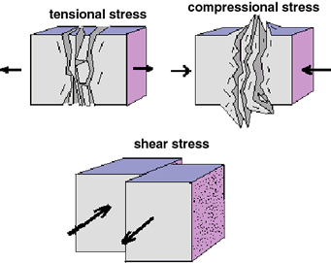
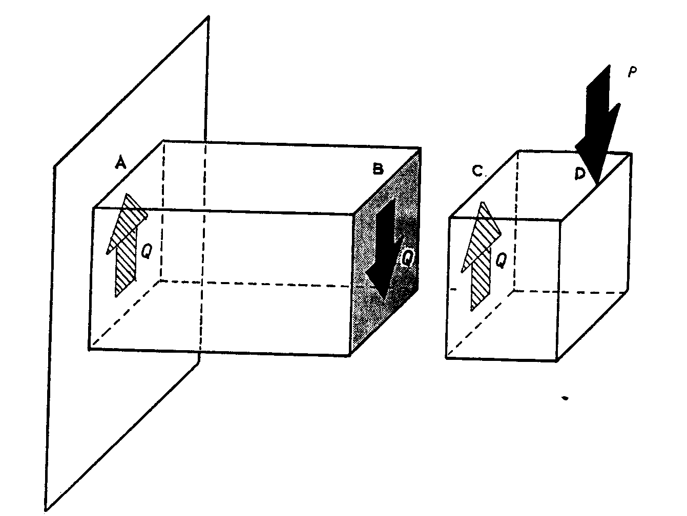
SHEAR STRESS

Slide 34
SHEAR STRESS
P
P
R
R
P
P
Fig. a
Fig. b
Fig. c
This shear stress will always be tangential to the area on which it acts
Notes:
Consider a block or portion of a material shown in Fig.(a) subjected to a set of equal and opposite forces P. then there is a tendency for one layer of the material to slide over another to produce the form failure as shown in Fig.(b)
The resisting force developed by any plane ( or section) of the block will be parallel to the surface as shown in Fig.(c).
The resisting forces acting parallel to the surface per unit area is called as shear stress.

Slide 35
SHEAR STRAIN
τ
τ
B'
C'
B
C
B
C
A
D
A
D
τ
τ
Fig. d
Fig. e
Shear modulus:
Notes:
If block ABCD subjected to shearing stress as shown in Fig.(d), then it undergoes deformation. The shape will not remain rectangular, it changes into the form shown in Fig.(e), as AB'C'D.
The angle of deformation phi is then termed as shear strain
The angle of deformation is measured in radians and hence is non-dimensional.
For materials within the proportionality limit the shear strain is proportional to the shear stress. Hence the ratio of shear stress to shear strain is a constant within the proportionality limit.
For Mild steel, G= 80GPa = 80,000MPa = 80,000N/mm²

Slide 36
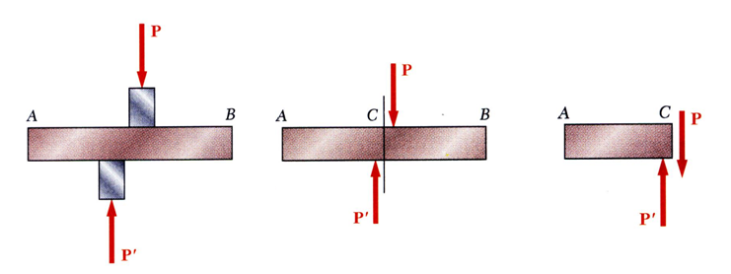

Notes:
Forces P and P‘ are applied transversely to the member AB.
Corresponding internal forces act in the plane of section C and are called shearing forces.
The resultant of the internal shear force distribution is defined as the shear of the section and is equal to the load P.
The corresponding average shear stress is,
The shear stress distribution cannot be assumed to be uniform.

Slide 37
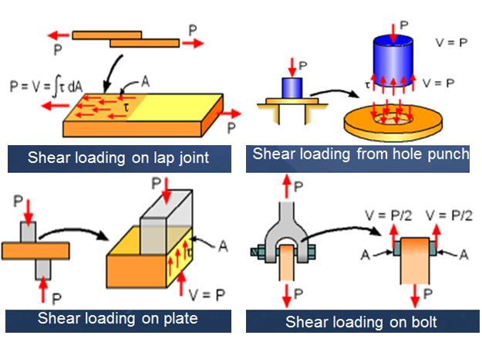
Examples of Shear

Slide 38

State of simple shear
P
A
B
D
C
P
(a)
(b)
Force on the face AB = P = τ × AB × t
For the force diagram shown,
ΣFx = 0, & ΣFy = 0, But ΣM not equal to 0
The element is subjected to a clockwise moment =P × AD
= (τ × AB × t) × AD
Notes:
Consider an element ABCD in a strained material subjected to shear stress, τ as shown in the figure (a) .
Force on the face AB = P = τ × AB × t
Where, t is the thickness of the element.
Force on the face DC is also equal to P
Now consider the equilibrium of the element.
(i.e., ΣFx = 0, ΣFy = 0, ΣM = 0.)
For the force diagram shown,
ΣFx = 0, & ΣFy = 0, But ΣM not equal to 0
The element is subjected to a clockwise moment =P × AD = (τ × AB × t) × AD
But, as the element is actually in equilibrium, there must be another pair of forces say P' acting on faces AD and BC, such that they produce a anticlockwise moment equal to ( P × AD ). (fig. c)
P ' × AB = P × AD = (τ × AB × t)× AD ----- (1)
If τ¹ is the intensity of the shear stress on the faces AD and BC, then P ' can be written as, P ' = τ ' × AD × t
Equation.(1) can be written as (fig. d)
(τ ' × AD× t ) × AB = (τ × AB × t) × AD ----- (1)
τ ' = τ
Thus in a strained material a shear stress is always accompanied by a balancing shear of same intensity at right angles to itself. This balancing shear is called “complementary shear”.
The shear and the complementary shear together constitute a state of simple shear.

Slide 39
State of simple shear
P
τ
A
B
A
B
P '
P '
τ '
τ '
D
C
P
D
C
(c)
τ
(d)
P ' × AB = P × AD = (τ × AB × t)× AD ----- (1)
If τ¹ is the intensity of the shear stress on the faces AD and BC, then P ' can be written as, P ' = τ ' × AD × t
(τ ' × AD× t ) × AB = (τ × AB × t) × AD ----- (1)
τ ' = τ
Notes:
Consider an element ABCD in a strained material subjected to shear stress, τ as shown in the figure (a) .
Force on the face AB = P = τ × AB × t
Where, t is the thickness of the element.
Force on the face DC is also equal to P
Now consider the equilibrium of the element.
(i.e., ΣFx = 0, ΣFy = 0, ΣM = 0.)
For the force diagram shown,
ΣFx = 0, & ΣFy = 0, But ΣM not equal to 0
The element is subjected to a clockwise moment =P × AD = (τ × AB × t) × AD
But, as the element is actually in equilibrium, there must be another pair of forces say P' acting on faces AD and BC, such that they produce a anticlockwise moment equal to ( P × AD ). (fig. c)
P ' × AB = P × AD = (τ × AB × t)× AD ----- (1)
If τ¹ is the intensity of the shear stress on the faces AD and BC, then P ' can be written as, P ' = τ ' × AD × t
Equation.(1) can be written as (fig. d)
(τ ' × AD× t ) × AB = (τ × AB × t) × AD ----- (1)
τ ' = τ
Thus in a strained material a shear stress is always accompanied by a balancing shear of same intensity at right angles to itself. This balancing shear is called “complementary shear”.
The shear and the complementary shear together constitute a state of simple shear.

Slide 40
Thus in a strained material a shear stress is always accompanied by a balancing shear of same intensity at right angles to itself. This balancing shear is called “complementary shear”.
The shear and the complementary shear together constitute a state of simple shear.

Slide 41

Direct stress due to pure shear
τ
τ
A
A
B
A
B
a
a
a
τ
a
τ
τ
τ
a
a
D
C
D
C
D
C
τ
X
τ
Fig.(a).
Fig.(b).
A
σ_{n}
τ
a
a
D
C
τ
Fig.(c).
For equilibrium,
Notes:
Consider a square element of side ‘a’ subjected to shear stress as shown in the Fig.(a). Let the thickness of the square be unity.
Fig.(b) shows the deformed shape of the element. The length of diagonal DB increases, indicating that it is subjected to tensile stress. Similarly the length of diagonal AC decreases indicating that compressive stress.

Slide 42
Direct stress due to pure shear
Therefore the intensity of normal tensile stress developed on plane BD is numerically equal to the intensity of shear stress.
Similarly it can be proved that the intensity of compressive stress developed on plane AC is numerically equal to the intensity of shear stress.

Slide 43
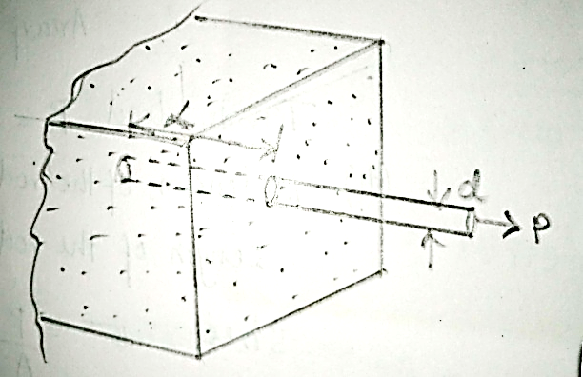
N8. To check the bond strength between reinforcing bars and concrete, a tensile force of P=30 kN is applied to the end of the bar of diameter d=12 mm and length L= 100 mm. Calculate the average shear stress developed between steel and concrete.

Slide 44
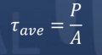
Given:
P=30 , bar diameter d=12 mm
length L= 100 mm.
average shear stress developed between steel and concrete =?

Slide 45
N9. A hole is to be punched out of a plate having an ultimate shear stress of 300 MPa. If the compressive stress in the punch is limited to 400 MPa,
determine:
(a) Maximum thickness of the plate for which a 100 mm dia hole can be punched.
(b) If the plate is 10mm thick, smallest diameter hole that can be punched.
Ans:
t=33.33 mm
d=30 mm

Slide 46
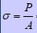
Given:
ultimate shear stress of 300 MPa.
compressive stress in the punch is 400 MPa
(a) Maximum thickness of the plate for which a 100 mm dia hole can be punched.
compressive stress
ultimate shear stress

Slide 48
Given:
ultimate shear stress of 300 MPa.
compressive stress in the punch is 400 MPa
(b) If the plate is 10mm thick, smallest diameter hole that can be punched.
compressive stress
ultimate shear stress

Slide 49
Ans:
t=33.33 mm
d=30 mm

Slide 50
Poisson’s ratio Volumetric strain Bulk modulus Relationship between volumetric strain and linear strain
LECTURE 19
Contents:
HOME
Notes:
`

Slide 51
Notes:
Consider the rectangular bar shown in Fig.(a) subjected to a tensile load. Under the action of this load the bar will increase in length by an amount δL giving a longitudinal strain in the bar.
The bar will also exhibit, reduction in dimension laterally, i.e. its breadth and depth will both reduce. These change in lateral dimension is measured as strains in the lateral direction as given below.
The associated lateral strains will be equal and are of opposite sense to the longitudinal strain.
Provided the load on the material is retained within the elastic range the ratio of the lateral and longitudinal strains will always be constant. This ratio is termed Poisson’s ratio (µ)

Slide 52
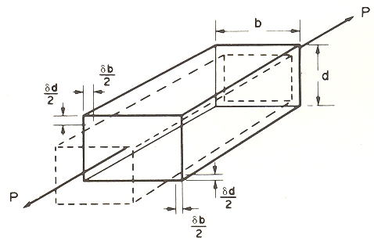





POISSON’S RATIO
Fig.(a)
or
Notes:
Consider the rectangular bar shown in Fig.(a) subjected to a tensile load. Under the action of this load the bar will increase in length by an amount δL giving a longitudinal strain in the bar.
The bar will also exhibit, reduction in dimension laterally, i.e. its breadth and depth will both reduce. These change in lateral dimension is measured as strains in the lateral direction as given below.
The associated lateral strains will be equal and are of opposite sense to the longitudinal strain.
Provided the load on the material is retained within the elastic range the ratio of the lateral and longitudinal strains will always be constant. This ratio is termed Poisson’s ratio (µ)

Slide 53
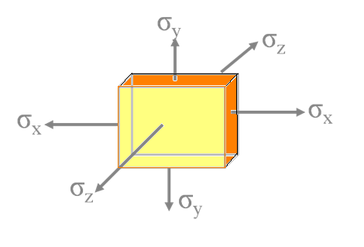
General case:
Strain in X-direction =
Strain in Y-direction =
Strain in Z-direction =
Notes:
For most engineering metals the value of µ lies between 0.25 and 0.33

Slide 57

Bulk Modulus
Bulk modulus, K
A body subjected to three mutually perpendicular equal direct stresses then the ratio of stress to volumetric strain is called Bulk Modulus.
Notes:
A body subjected to three mutually perpendicular equal direct stresses undergoes volumetric change without distortion of shape.
If V is the original volume and dV is the change in volume, then dV/V is called volumetric strain.
A body subjected to three mutually perpendicular equal direct stresses then the ratio of stress to volumetric strain is called Bulk Modulus.

Slide 58
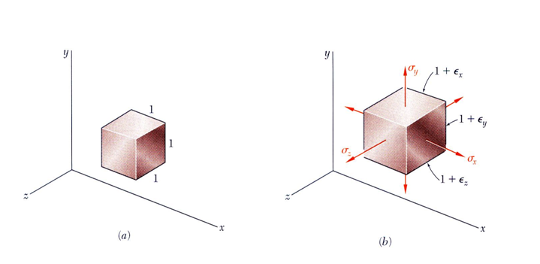
Relationship between volumetric strain and linear strain
Notes:
Consider a cube of side 1unit, subjected to three mutually perpendicular direct stresses as shown in the figure.
Relative to the unstressed state, the change in volume per unit volume is

Slide 59
Relationship between volumetric strain and linear strain

Slide 60





For element subjected to uniform hydrostatic pressure,

Slide 61
N10. A bar of metal 100x50 mm in cross section is 250 mm long. It carries a tensile load of 400 kN in the direction of its length, a compressive load of 4000 kN on its 100 mm x 250 mm faces and a tensile load of 2000 kN on its 50 mm x 250 mm faces. If E=2x10⁵ N/mm² and poisson’s ratio is 0.25, find the change in volume of the bar.
What change must be made in the 4000 kN load in order that there shall be no change in volume of the bar.

Slide 63
N11. A bar of steel 40 mm x 40 mm cross section and 150 mm long is subjected to a tensile load of 200 kN along its longitudinal axis and tensile load of 600 kN and 400 kN along lateral axis.
Find,
(a) Change in each dimension and change in volume
(b) What longitudinal force alone can produce same longitudinal strain as in case (a).
Given E= 200 GPa μ=0.3

Slide 64
600 kN
200 kN
200 kN
400 kN

Slide 65
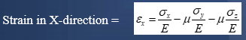
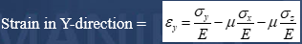
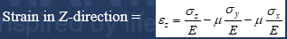

Slide 68
Relationship between modulus of elasticity and modulus of rigidity Relationship between E, G and K Application problems
LECTURE 20
Contents:
HOME

Slide 69
Relationship between young’s modulus of elasticity (E) and modulus of rigidity (G) :-
A¹
A
B¹
45˚
a
H
a
B
φ
τ
φ
D
C
τ
Notes:
Consider a square element ABCD of side ‘a’ subjected to pure shear‘τ’. DA'B'C is the deformed shape due to shear τ.
Drop a perpendicular AH to diagonal A'C.
Strain in the diagonal AC = τ /E – μ (- τ /E) [ σ_{n}= τ ]
= τ /E [ 1 + μ ] -----------(1)
Strain along the diagonal AC=(A'C–AC)/AC=(A'C–CH)/AC=A'H/AC
In Δle AA'H
Cos 45˚ = A'H/AA'
A'H= AA' × 1/√2
AC = √2 × AD ( AC = √ AD² +AD²)
Strain along the diagonal AC = AA'/ (√2 × √2 × AD)=φ/2 ----(2)
Modulus of rigidity = G = τ /φ
φ = τ /G
Substituting in (2)
Strain along the diagonal AC = τ /2G -----------(3)
Equating (1) & (3)
τ /2G = τ /E[1+μ]

Slide 70
Relationship between young’s modulus of elasticity (E) and modulus of rigidity (G) :-
A¹
A
B¹
45˚
a
H
a
B
φ
τ
φ
D
C
τ
Notes:
Consider a square element ABCD of side ‘a’ subjected to pure shear‘τ’. DA'B'C is the deformed shape due to shear τ.
Drop a perpendicular AH to diagonal A'C.
Strain in the diagonal AC = τ /E – μ (- τ /E) [ σ_{n}= τ ]
= τ /E [ 1 + μ ] -----------(1)
Strain along the diagonal AC=(A'C–AC)/AC=(A'C–CH)/AC=A'H/AC
In Δle AA'H
Cos 45˚ = A'H/AA'
A'H= AA' × 1/√2
AC = √2 × AD ( AC = √ AD² +AD²)
Strain along the diagonal AC = AA'/ (√2 × √2 × AD)=φ/2 ----(2)
Modulus of rigidity = G = τ /φ
φ = τ /G
Substituting in (2)
Strain along the diagonal AC = τ /2G -----------(3)
Equating (1) & (3)
τ /2G = τ /E[1+μ]

Slide 71
Notes:
Consider a square element ABCD of side ‘a’ subjected to pure shear‘τ’. DA'B'C is the deformed shape due to shear τ.
Drop a perpendicular AH to diagonal A'C.
Strain in the diagonal AC = τ /E – μ (- τ /E) [ σ_{n}= τ ]
= τ /E [ 1 + μ ] -----------(1)
Strain along the diagonal AC=(A'C–AC)/AC=(A'C–CH)/AC=A'H/AC
In Δle AA'H
Cos 45˚ = A'H/AA'
A'H= AA' × 1/√2
AC = √2 × AD ( AC = √ AD² +AD²)
Strain along the diagonal AC = AA'/ (√2 × √2 × AD)=φ/2 ----(2)
Modulus of rigidity = G = τ /φ
φ = τ /G
Substituting in (2)
Strain along the diagonal AC = τ /2G -----------(3)
Equating (1) & (3)
τ /2G = τ /E[1+μ]

Slide 72
Relationship between E, G, and K:-
We have
E = 2G( 1+ μ) -----------(1)
E = 3K( 1-2μ) -----------(2)
Equating (1) & (2)
2G( 1+ μ) =3K( 1- 2μ)
2G + 2Gμ=3K- 6Kμ
μ= (3K- 2G) /(2G +6K)
Substituting in (1)
E = 2G[ 1+(3K – 2G)/ (2G+6K)]
E = 18GK/( 2G+6K)
E = 9GK/(G+3K)
Notes:
We have
E = 2G( 1+ μ) -----------(1)
E = 3K( 1-2μ) -----------(2)
Equating (1) & (2)
2G( 1+ μ) =3K( 1- 2μ)
2G + 2Gμ=3K- 6Kμ
μ= (3K- 2G) /(2G +6K)
Substituting in (1)
E = 2G[ 1+(3K – 2G)/ (2G+6K)]
E = 18GK/( 2G+6K)

Slide 73
N12.A circular rod of 100 mm dia and 500 mm length is subjected to a tensile force of 2000 kN. Determine the modulus of rigidity, bulk modulus and the change in volume, if the poisson’s ratio=0.3 and E=2x10⁵ N/mm².

Slide 76
Ans:
G=0.77x10⁵ N/mm²
K=1.67x10⁵ N/mm²
dv=1994.9 mm³

Slide 77
N13. The modulus of rigidity of a material is 0.8 x 10⁵ N/mm² . When a 6 mm x 6 mm bar of this material is subjected to an axial pull of 3600 N, it was found that the lateral dimension of bar is changed to 5.9991 mm x 5.9991 mm.
Find μ and E.

Slide 79
Ans:
µ=0.32
E=2.105x10⁵ N/mm²

Slide 80
TUTORIAL 8
Contents:
Tutorial problems
HOME

Slide 81
T1. Find the Young’s modulus of a brass rod of diameter 25 mm and of length 250 mm which is subjected to a tensile load of 75 kN when the extension of the rod is equal to 0.3 mm.
T2. The ultimate stress, for a hollow steel column which carries an axial load of 2.0 MN is 480 N/mm². If the external diameter of the column is 200 mm, determine the internal diameter. Take factor of safety as 3.

Slide 82
T3. A brass bar having cross section area of 900 mm², is subjected to axial forces as shown below. The lengths of portion AB, BC and CD are 0.6 m, 0.8 m and 1.0 m respectively. Determine the total elongation of the bar. Take E = 100 GPa.
A
B
C
D
40 kN
10 kN
70 kN
20 kN

Slide 84
T4. A tensile load of 80 kN is acting on a rod of diameter 80 mm and of length 8 m. A bore of diameter 60 mm is made centrally on the rod. To what length the rod should be bored so that the total extension will increase 25% under the same tensile load. Take E = 200 GPa.

Slide 85
TUTORIAL 9
Contents:
Tutorial problems
HOME

Slide 86
T5. A steel flat of thickness 16 mm tapers uniformly from 80 mm at one end to 50 mm at the other end in a length of 800 mm, If the flat is subjected to a load of 120 kN, find the extension of the flat. Also calculate the percentage error if average area is used for calculating its extension. Take E=2x10⁵ Mpa

Slide 87
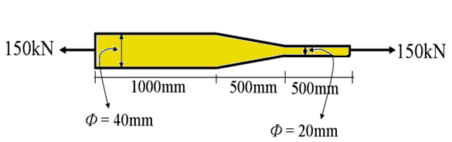
T6. A two meter long steel bar is having uniform diameter of 40 mm for a length of 1 m, in the next 0.5 m its diameter gradually reduces to 20 mm and for remaining 0.5 m length diameter remains 20 mm uniform as shown in the figure. If a load of 150 kN is applied at the ends, find the stresses in each section of the bar and total extension of the bar. Take E = 200 GPa.

Slide 88
T7. A tensile load of 50 kN is acting on rod of 50 mm diameter and length of 5m. Determine the length of a bore of 25mm that can be made central in the rod, if the total extension is not to exceed by 25 percent under the same tensile load. Take E = 2.05 x 10⁵ N/mm²

Slide 89
TUTORIAL 10
Contents:
Tutorial problems
HOME

Slide 90
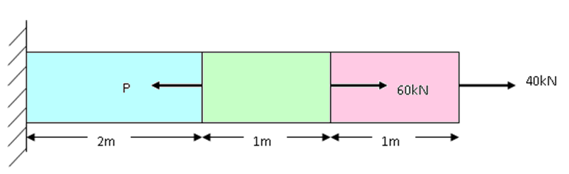
T8. Determine the magnitude of the load P necessary to produce zero net change in the length of the bar shown in the figure below. Take A=400 mm².
Ans:
P=170 kN

Slide 91
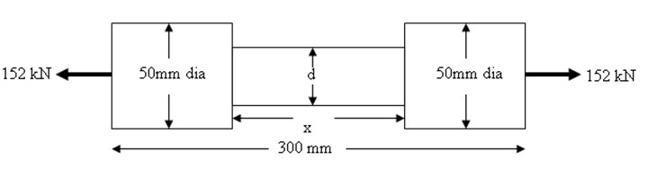
T9. For the bar shown below, determine diameter of the central portion and its length, if the total extension of the bar is 0.16 mm. Take E=200 GPa. Stress at central portion is limited to 140 N/mm²
Ans:
d=37.18mm
x=140.23mm
HOME

Slide 92
T10. A tension test is carried out subjected on a mild steel tube of external diameter 18 mm and internal diameter 12 mm. An an axial load of 2 kN produces an extension of 3.36 x 10⁻³ mm on a length of 50 mm and a lateral contraction of 3.62 x 10⁻⁴ mm of outer diameter.
Determine E, μ,G and K.
Ans:
E=2.11x10⁵ N/mm²
µ=0.3
G=81.15x10³ N/mm²
K=175.42x10³ N/mm²

Slide 93
ADDITIONAL
TUTORIAL PROBLEMS
HOME

Slide 94
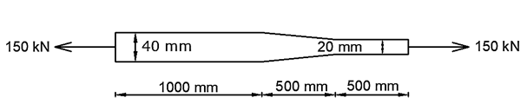
AT1. A two meter long steel bar is having uniform diameter of 40 mm for a length of 1 m, in the next 0.5 m its diameter gradually reduces to 20 mm and for remaining 0.5 m length diameter remains 20 mm uniform as shown in the figure. If a load of 150 kN is applied at the ends, find the stress in each section and total extension of the bar. Take E = 200 Gpa

Slide 95
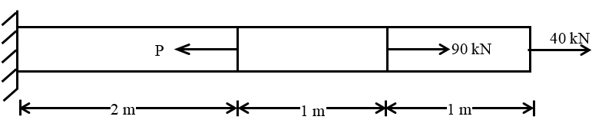
AT2. Determine the magnitude of the load P necessary to produce zero net change in the length of the bar shown in the figure below. Take A=400 mm².

Slide 96
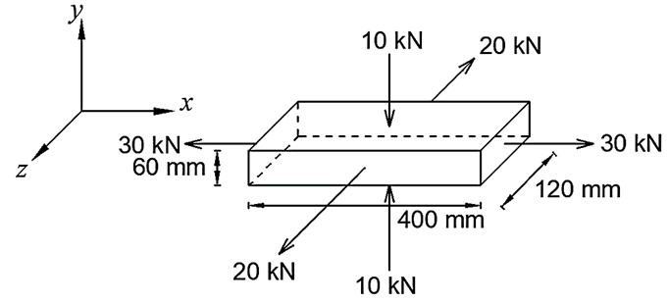
AT3. A steel bar of 400 mm x 120 mm x 60 mm is subjected to forces as shown in the figure. Find the change in dimension. Taking E = 200 GPa and µ = 0.25.

